Slide 1
For complete conference evaluation
6th ISC

Slide 2
In your conference participation certificate you will find in the right bottom, a number in the end of the reference

Slide 3
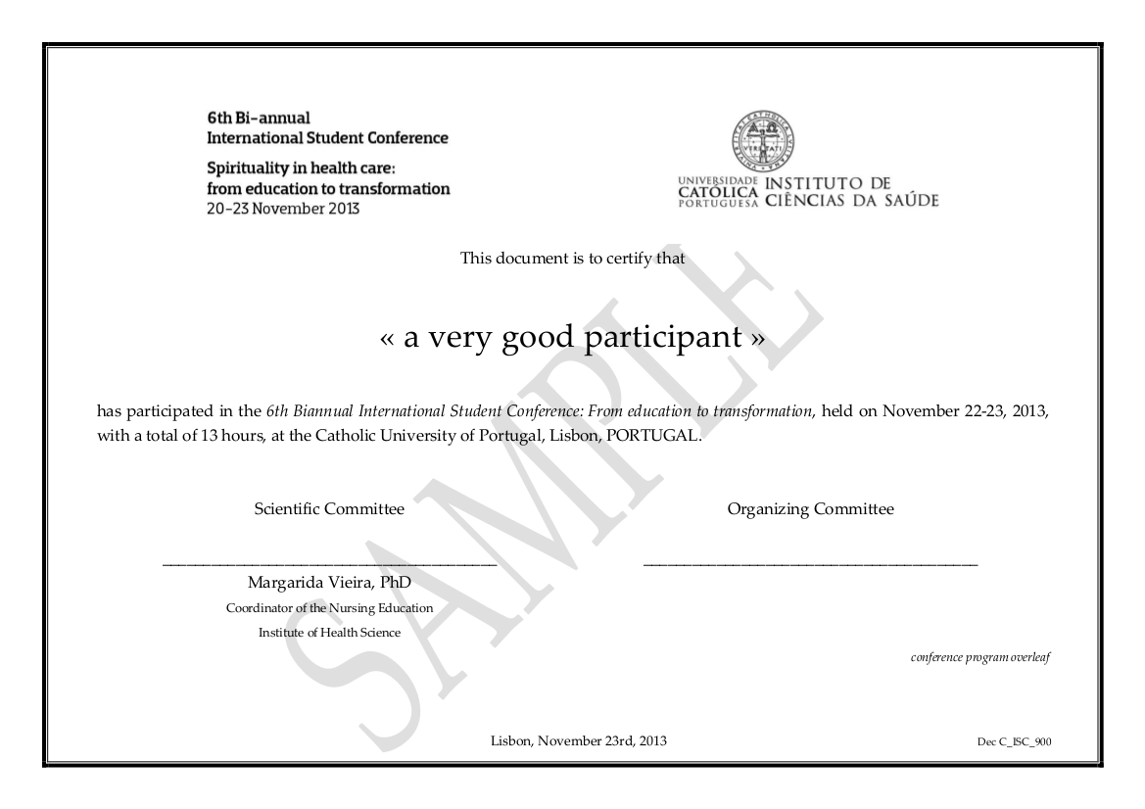

Slide 4
Please use only the number you find in this place in your certificate

Slide 5
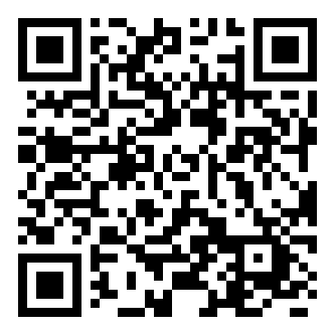
Them, go to the form and insert the number in “verification code” field
And, please, answer the conference evaluation programme
Thank you

